Slide 1
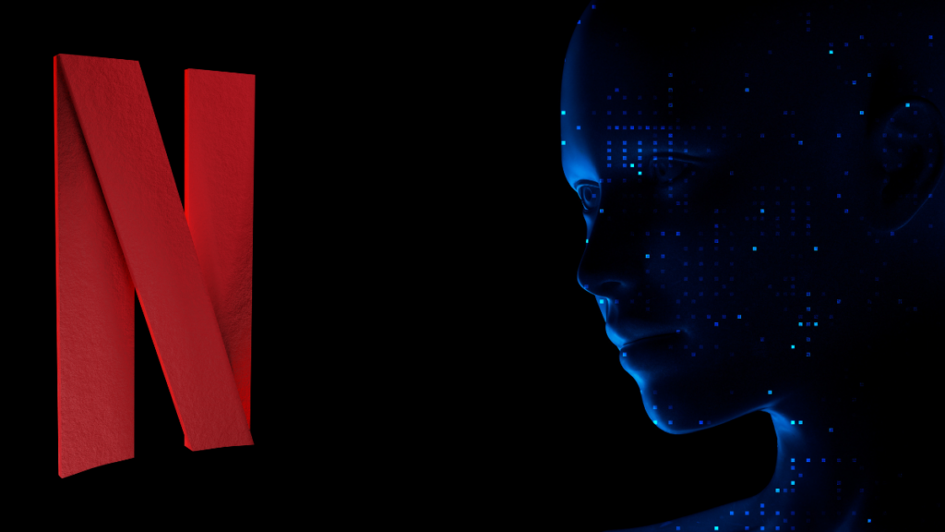
EDA On Netflix Movies And TV Shows Dataset
Presented By : Harsh Mishra
Guide By : Naina Devi
College : Techno India University

Slide 2
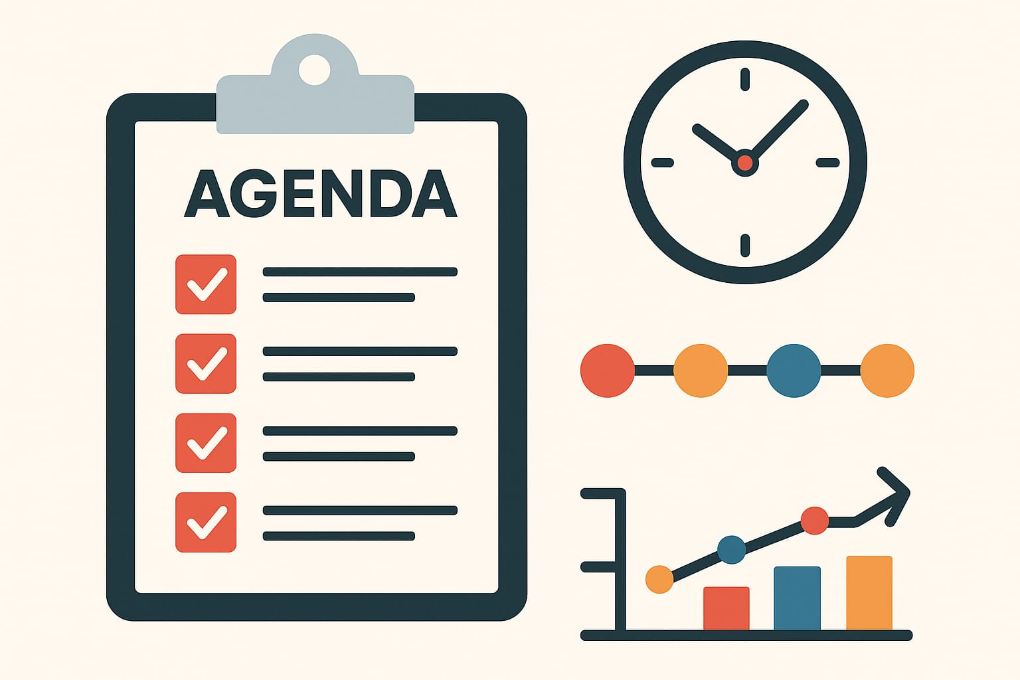
AGENDA:
To understand the composition and trends of Netflix’s content library.
To analyze movies and TV shows based on country, genre, release year, and ratings.
To visualize data insights through graphs and charts.
To identify patterns in Netflix’s content strategy

Slide 3
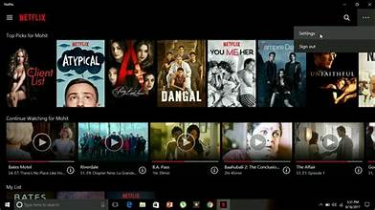
Introduction :
This project performs Exploratory Data Analysis (EDA) on Netflix’s Movies and TV Shows dataset. The dataset includes information like title, director, cast, country, release year, rating, duration, and type of content. The goal is to gain meaningful insights into Netflix’s content distribution and trends. Through data cleaning, visualization, and analysis, the project helps understand what kind of content Netflix produces most, how it has evolved over time, and which countries contribute the most to its library.

Slide 4
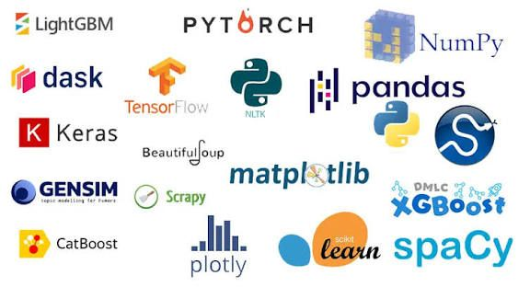
LIBRARIES AND TECHNOLOGIES USED
Programming Language: Python
Libraries Used:
Numpy for data manipulation
Matplotlib
Sckit learn for predictive modeling
Joblib for model serialization
Deployment and Interface:
Streamlit for rapid development
Render for cloud deployment
Dataset Source:
Kaggle
Mymoviedb.csv provides rich features for Netflix shows EDA
Development in Jupyter Notebook and version control with GitHub

Slide 5
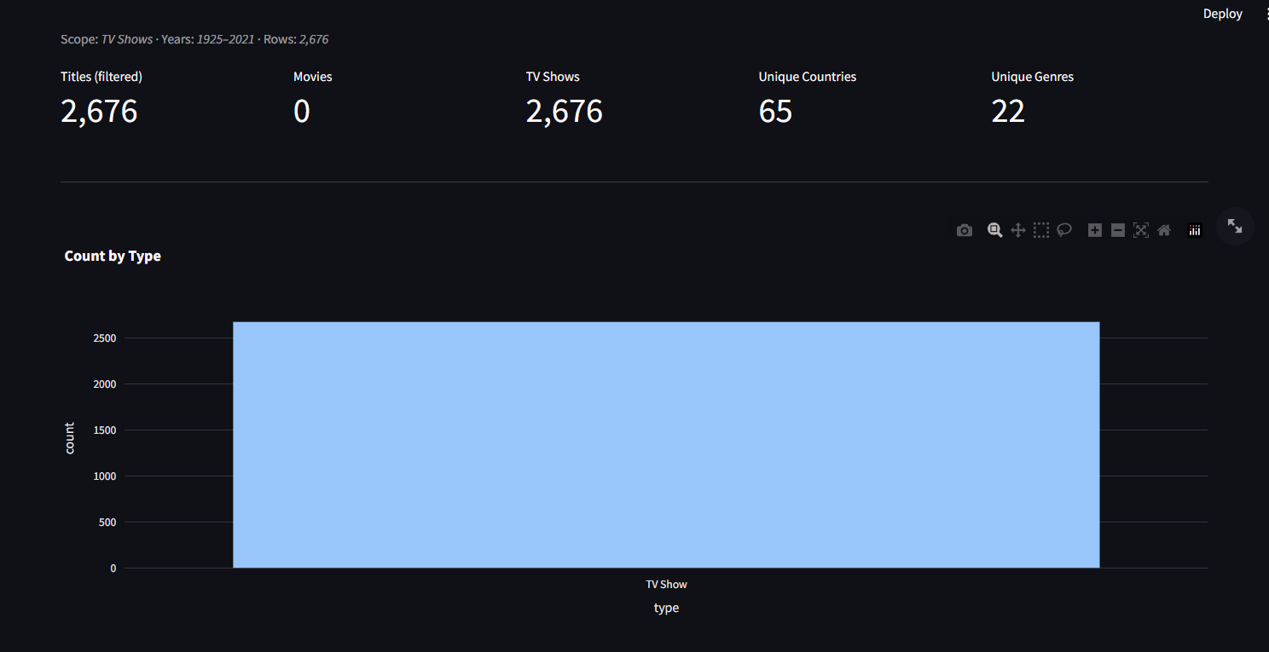
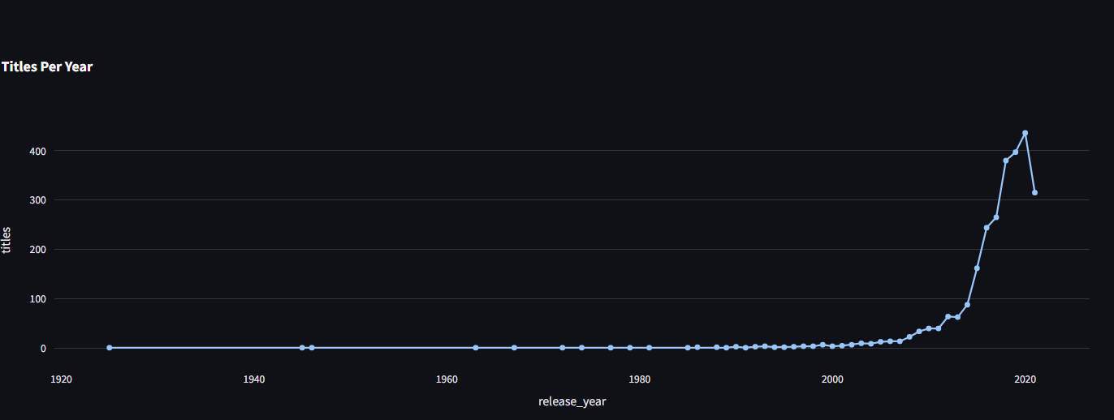
PROJECT WORKING:

Slide 6
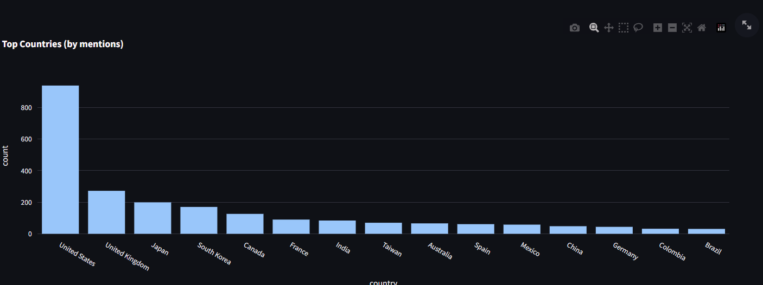
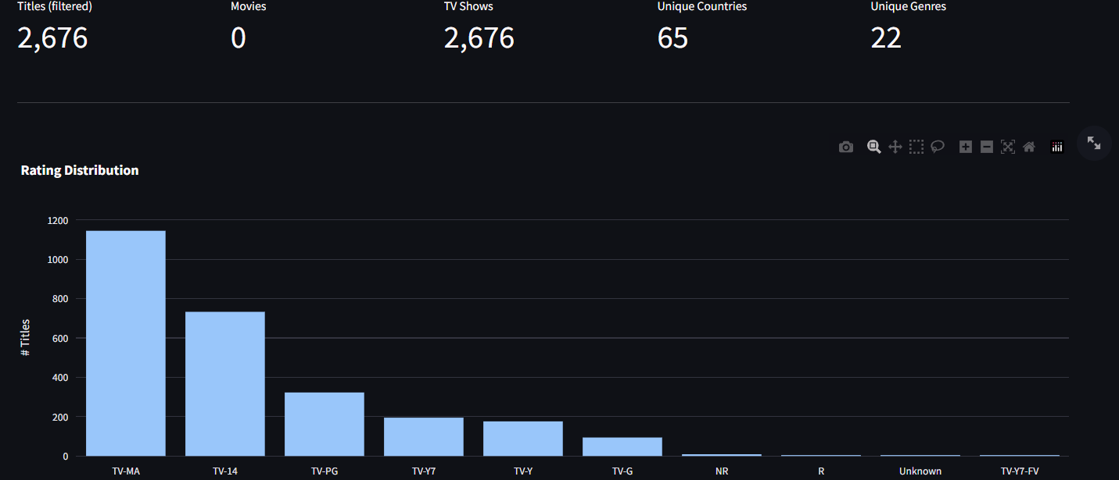

Slide 7
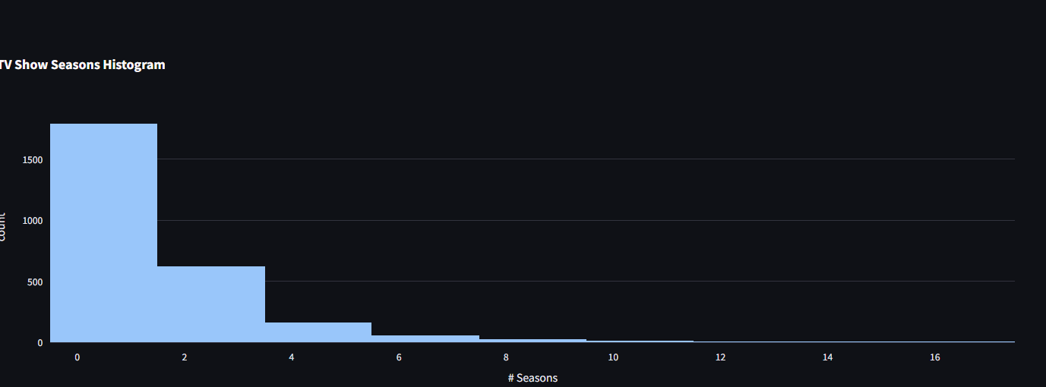
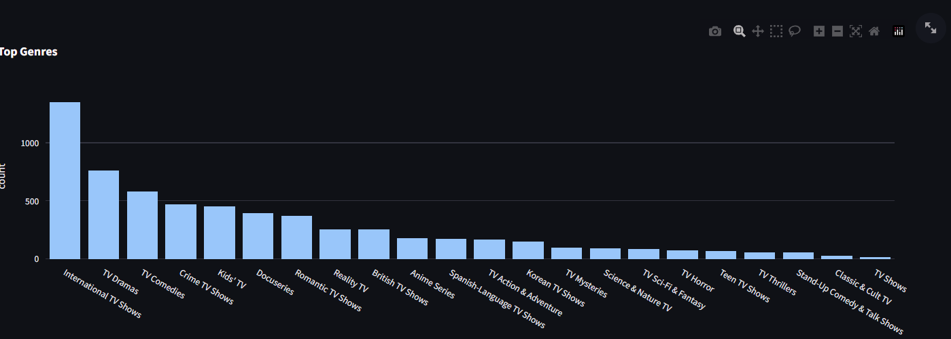

Slide 8
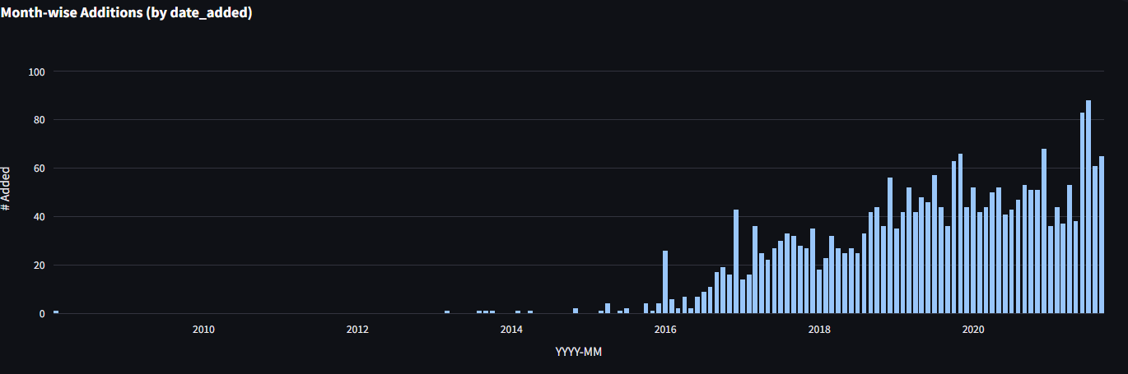
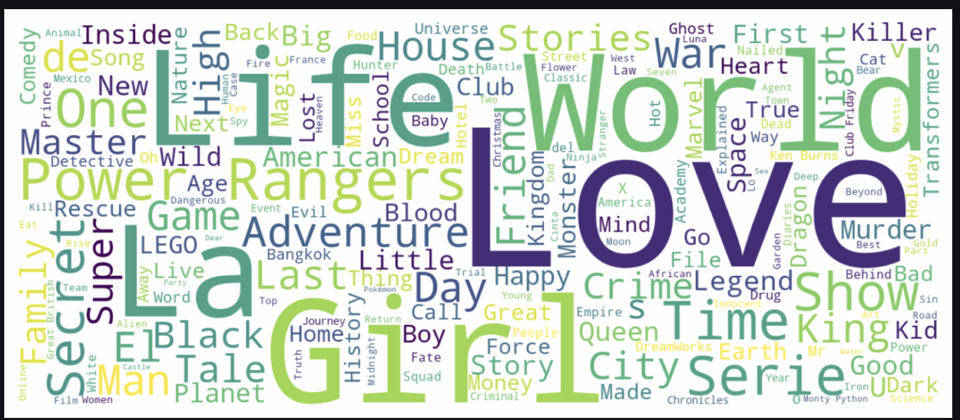
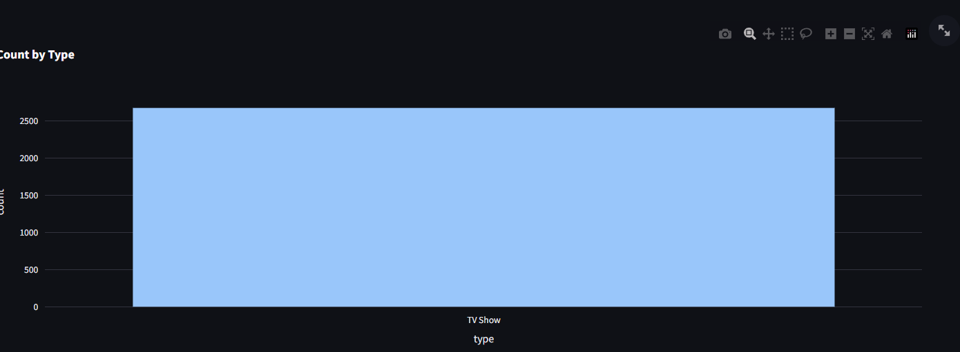

Slide 9

APPLICATIONS:
Helps Netflix and other streaming services understand global content trends.
Useful for data analysts and entertainment researchers.
Supports decision-making in content acquisition and production.
Educational use for learning data visualization and analytics.
n

Slide 10
PROBLEM Faced and its solutions:
CHALLENGES
SOLUTIONS
Missing Values:
Many entries in director, cast, and country columns were missing.
Duplicate Records:
Some titles appeared more than once in the dataset.
Unformatted Dates and Durations:
The date_added and duration columns had inconsistent formats.
.
Cluttered Visualizations:
Graphs were overcrowded with too many categories.
Filled missing values with “Unknown” or removed incomplete rows using Pandas.
Used drop_duplicates() to clean the data and ensure accuracy.
Converted them to proper formats using pd.to_datetime() and string operations.
Displayed only top 10 values for better clarity and presentation

Slide 11
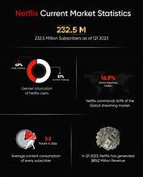
FUTURE SCOPE:
Extend analysis using machine learning to predict content popularity.
Include IMDb ratings and viewer engagement data for deeper insights.
Create an interactive dashboard using Power BI or Tableau.
Automate updates with Netflix’s latest data through APIs.

Slide 12
PROJECT LINK :
https://github.com/MishraHarsh25/EDA-on-Netflix
https://eda-on-netflix-sgse.onrender.com/

Slide 13
THANK YOU

